Slide 1
Introduction to Model Driven Programmability
Srivatsa M B

Slide 2
Agenda
The Road to Model Driven Programmability
Introduction to YANG Data Models
Introduction to NETCONF
Introduction to RESTCONF
Conclusion and Q/A
Note: All code samples referenced in this presentation are available at
https://github.cisco.com/XXX

Slide 3
The Road to Model Driven Programmability

Slide 4
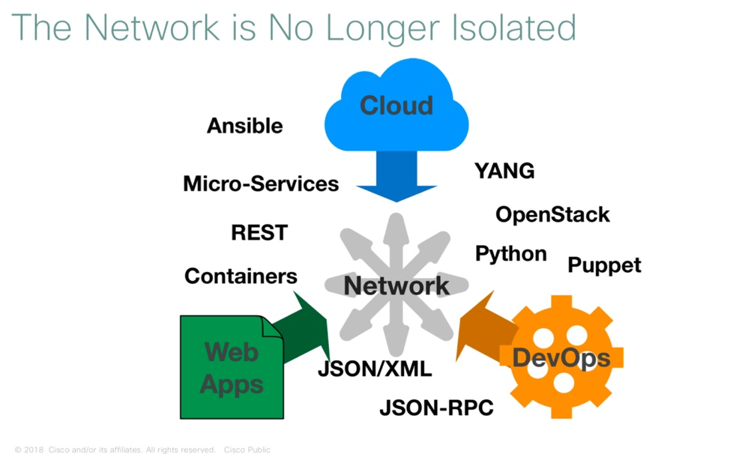
IDEA?!!! what It would take to Configure 12,000 devices at one GO!!
Could be an Interpreter!! BASH?

Slide 5
Could be SNMP?
Simple Network Management Protocol (SNMP) is an application-layer protocol used to manage and monitor network devices and their functions.
Typical config: SNMPv2 read- only community strings
Typical usage: interface statistics queries and traps
Empirical Observation: SNMP is not used for configuration
Lack of Writeable.
Security Concerns
Difficult to Replay/Rollback
Special Applications
SNMP works “reasonably well for device monitoring”
RFC 3535: Overview of the 2002 IAB Network Management Workshop – 2003 https://tools.ietf.org/html/rfc3535

Slide 6

RFC 3535: What is Needed? Group to Decide the Next generation Network Programmability??
A programmatic interface for device configuration
Separation of Configuration and State Data
Ability to configure "services" NOT "devices"
Integrated error checking and recovery
What do we need?

Slide 7
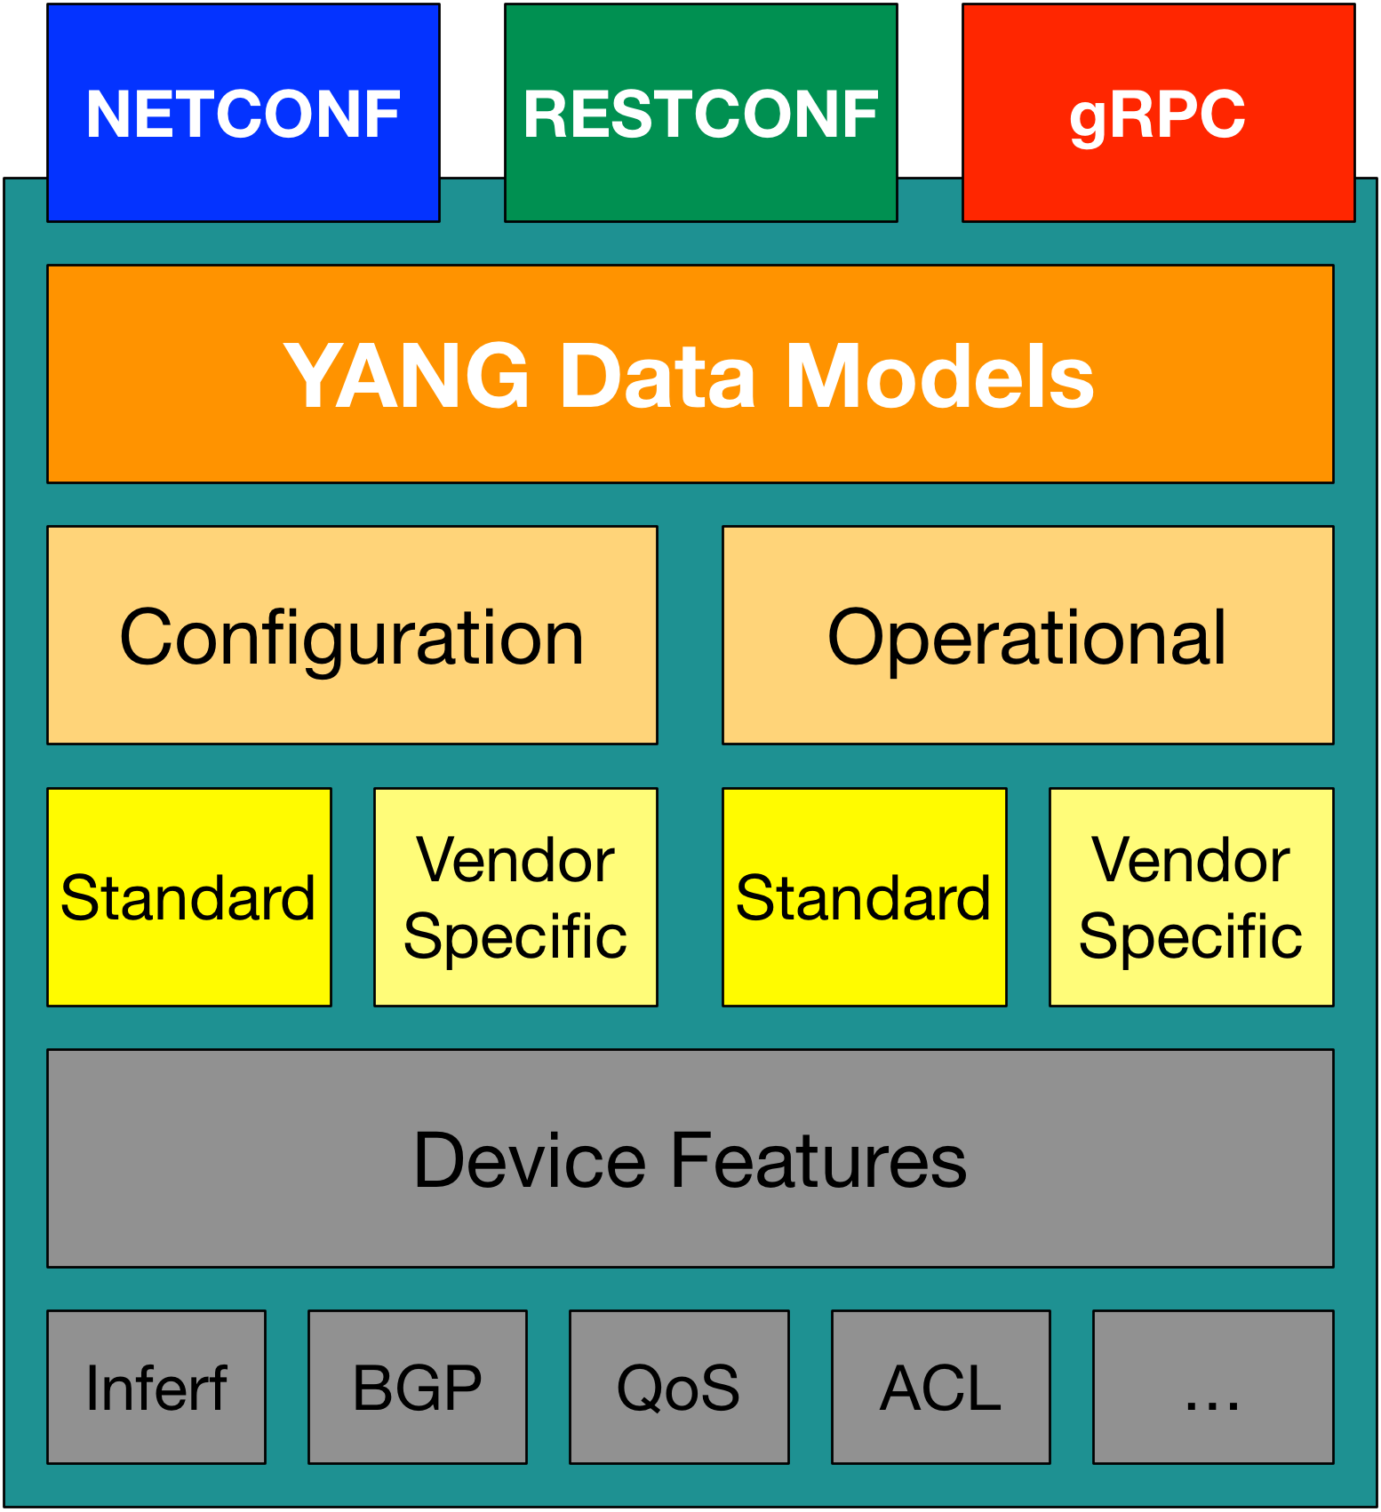
Model Driven Programmability New Methodology on Network?
NETCONF – 2006 – RFC 4741 (RFC 6241 in 2011)
YANG – 2010 – RFC 6020
RESTCONF – 2017 – RFC 8040
gRPC – 2015 – OpenSource project by Google

Slide 8
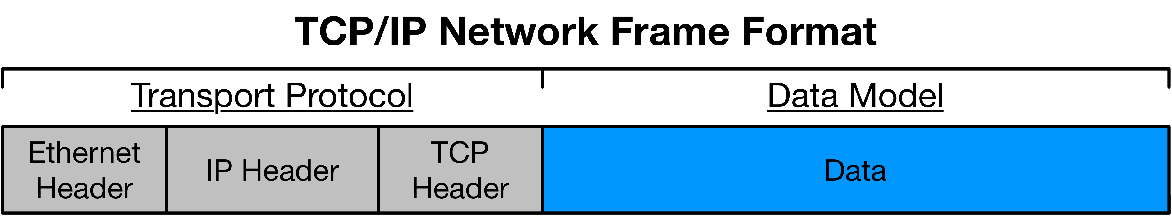
Transport (Protocol) vs Data (Model)
NETCONF
RESTCONF
gRPC
YANG

Slide 9
What is YANG?
YANG is a data modeling language for the NETCONF configuration management protocol. Together, NETCONF and YANG provide the tools that network administrators need to automate configuration tasks across multiple devices in a software-defined network (SDN).

Slide 10
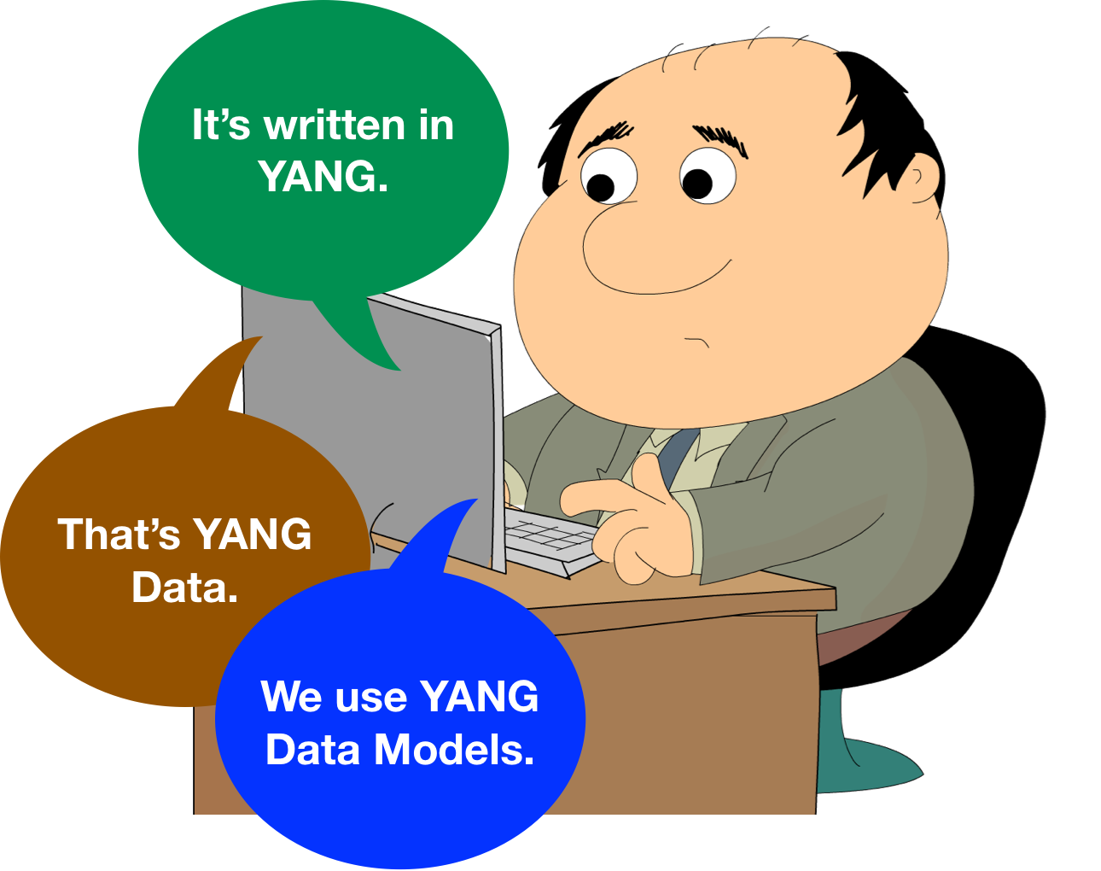
Three Meanings of “YANG”
10

Slide 11
YANG Modeling Language
Module that is a self-contained top-level hierarchy of nodes
Uses containers to group related nodes (On most of the cases it contains Configuration details or operation details)
Lists to identify nodes that are stored in sequence
Each individual attribute of a node is represented by a leaf (Leaf is a unique piece of information)
Every leaf must have an associated type ( In below example Boolean)
module ietf-interfaces { import ietf-yang-types {
prefix yang;
}
container interfaces { list interface {
key "name";
leaf name { type string;
}
leaf enabled { type boolean; default "true";
}
}
Example edited for simplicity and brevity
11

Slide 12
What is a Data Model?
Person
Gender - male, female, other
Height - Feet/Inches or Meters
Weight - Pounds or Kilos
Hair Color - Brown, Blond, Black, Red, other
Eye Color - Brown, Blue, Green, Hazel, other
A data model is simply a well understood and agreed upon method to describe "something". As an example, consider this simple "data model" for a person.
12

Slide 13


What might a YANG Data Model describe?
Device Data Models
Interface
VLAN
Device ACL
Tunnel
OSPF
etc
Service Data Model
L3 MPLS VPN
MP-BGP
Network ACL
EVPN
System Management
Network Faults
etc
13

Slide 14
Working with YANG Data Models

Slide 15




Where do Models Come From?
Industry Standard
Vendor Specific
Standard definition
(IETF, ITU, OpenConfig, etc.)
Compliant with standard
ietf-diffserv-policy.yang ietf-diffserv-classifer.yang ietf-diffserv-target.yang
Vendor definition
(i.e. Cisco)
Unique to Vendor Platforms cisco-memory-stats.yang cisco-flow-monitor
cisco-qos-action-qlimit-cfg
https://github.com/YangModels/yang

Slide 16
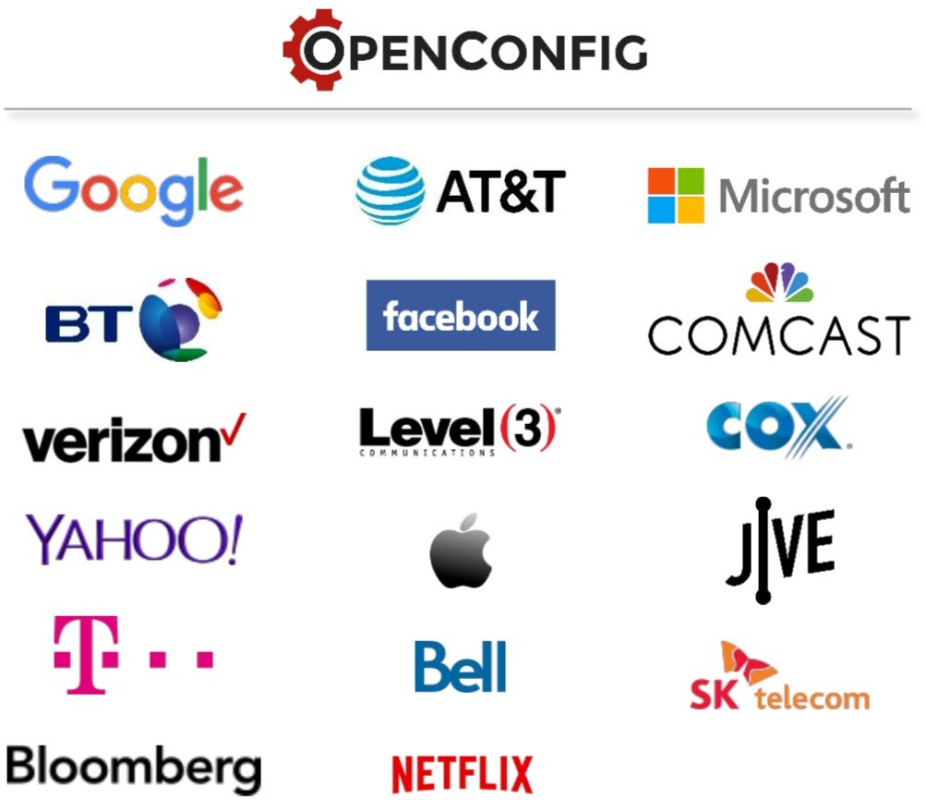
What is OpenConfig?
Models Designed by Operators for Operators
“OpenConfig’s initial focus is on compiling a consistent set of vendor- neutral data models based on actual operational needs from use cases and requirements from multiple network operators.”
OpenConfig FAQ: www.openconfig.com

Slide 17
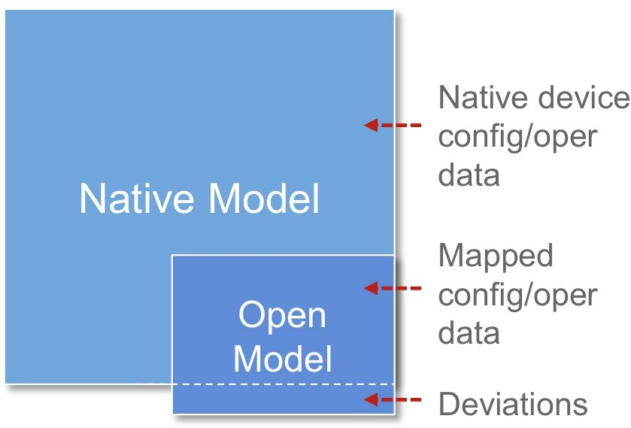
What is OpenConfig?
Models Designed by Operators for Operators
Focused on creating vendor-neutral data models written in YANG
Models combine both configuration and operational data
Model coverage still limited with an active development community
Support from multiple routing vendors (e.g. Cisco, Juniper, Arista)
Vendor exceptions carried a deviations

Slide 18
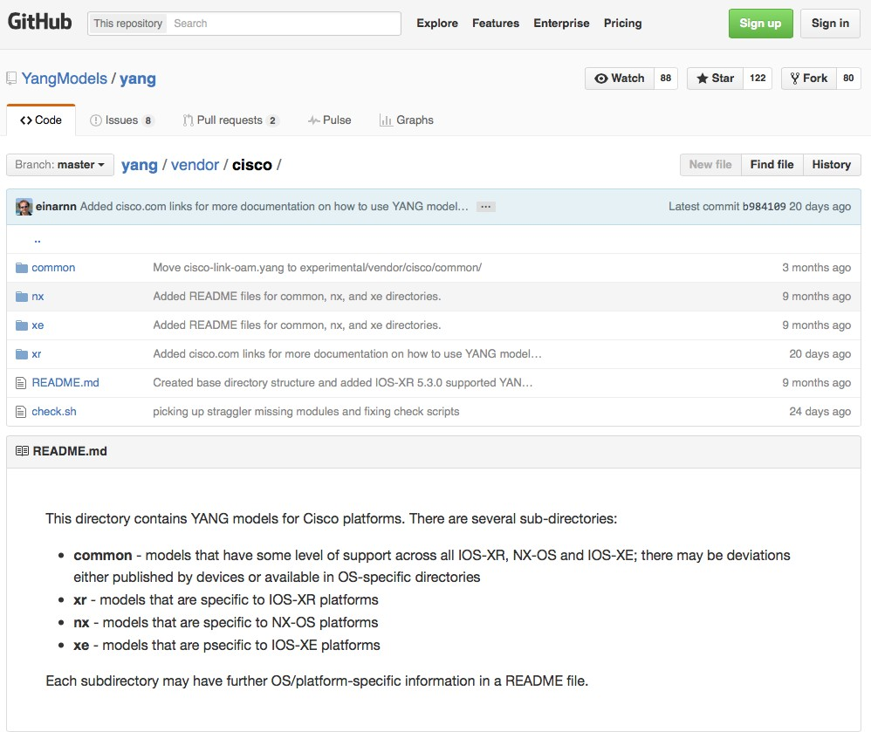
Where to get the Models?
For YANG modules from standard organizations such as the IETF, open source such as Open Daylight or vendor specific modules”
https://github.com/YangModels/yang
For OpenConfig models
https://github.com/openconfig/public

Slide 19
YANG Data Models
The model can be displayed and represented in any number of formats depending on needs at the time. Some options include:
YANG Language
Clear Text
XML
JSON
HTML/JavaScript

Slide 20
Working with YANG Models
DevNet$ pyang –f tree ietf-interfaces.yang
module: ietf-interfaces
+--rw interfaces
| | +--rw interface* [name]
| | +--rw name | string
| | +--rw description? | string
| | +--rw type | identityref
| | +--rw enabled? | boolean
| | +--rw link-up-down-trap-enable? | enumeration {if-mib}?
Example output edited for simplicity and brevity

Slide 21
Using pyang
Python YANG Library
Validate and display YANG files
Many formats for display
Text: tree
HTML: jstree

Slide 22



Augmentation and Deviations in YANG
Standard Model
Standard Model with Augmentation
Standard Model with
Deviation

Slide 23
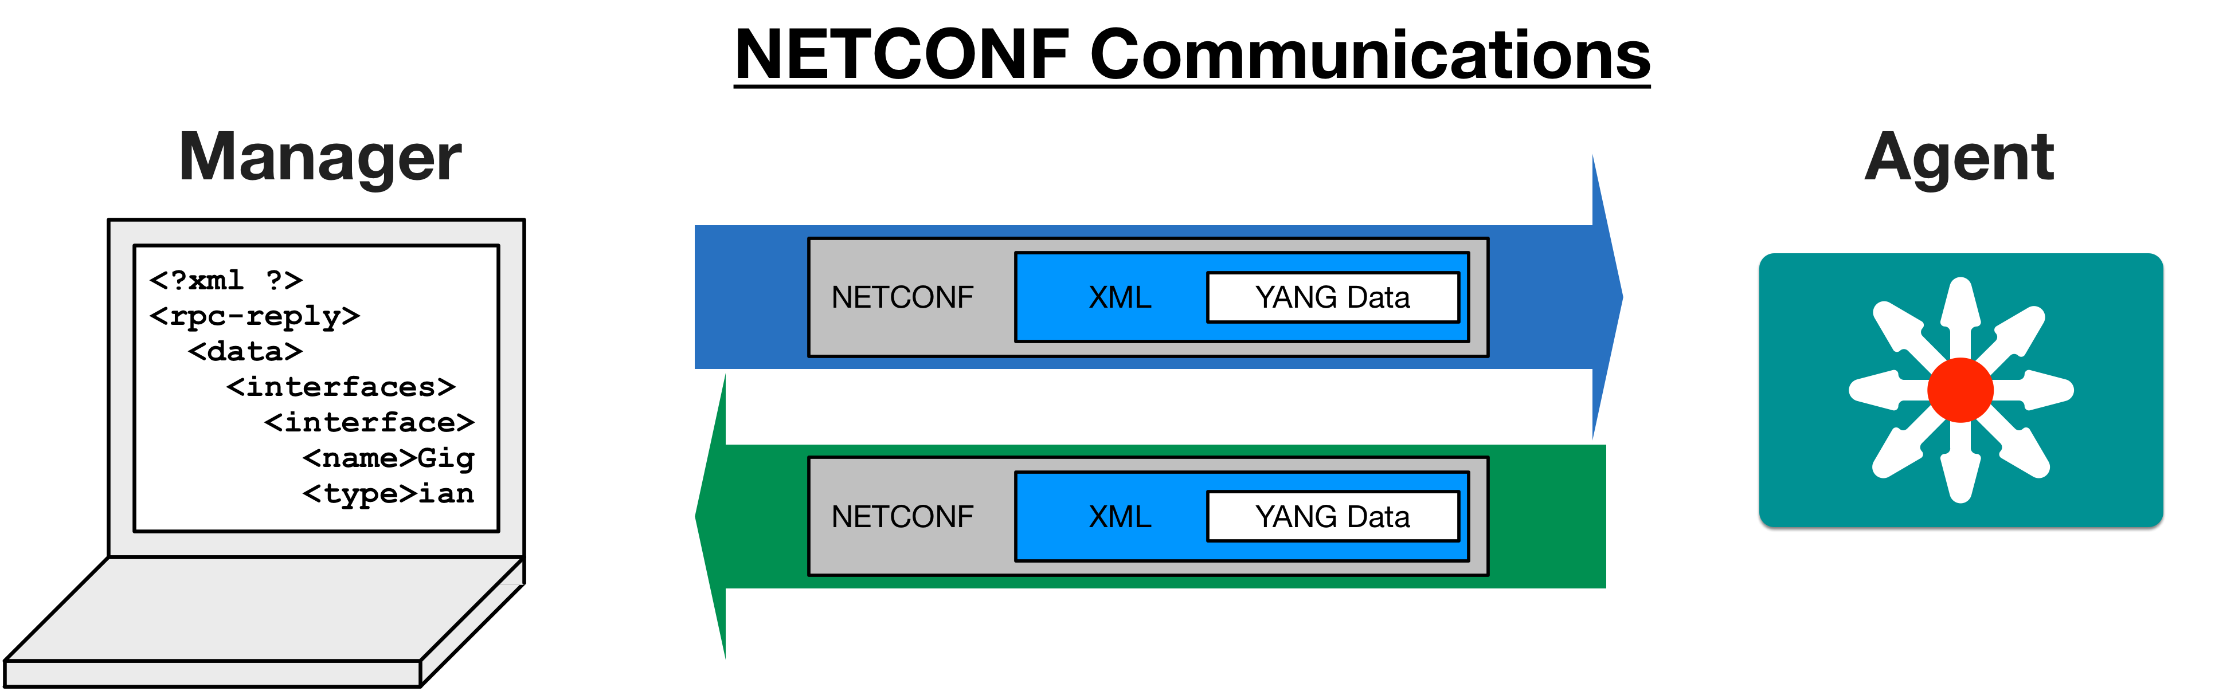

Actual Device Data Modeled in YANG

Slide 24
Use NETCONF to Retrieve ietf-interfaces data
from device_info import ios_xe1 from ncclient import manager import xml.dom.minidom
# NETCONF filter to use
netconf_filter = open("filter-ietf-interfaces.xml").read()
NETCONF details covered in another session
ncclient provides a Python client for NETCONF
Using built-in library to print reply
xml.dom.minidom
if name == ' main ':
with manager.connect(host=ios_xe1["address"],
port=ios_xe1["port"], username=ios_xe1["username"], password=ios_xe1["password"], hostkey_verify=False) as m:
netconf_reply = m.get_config("running", netconf_filter) interfaces = xml.dom.minidom.parseString(netconf_reply.xml) interfaces = interfaces.getElementsByTagName("interfaces") print(interfaces[0].toprettyxml())

Slide 25
Use NETCONF to Retrieve ietf-interfaces data
<description>DON'T TOUCH ME</description>
<type xmlns:ianaift="urn:ietf:params:xml:ns:yang:iana-if-type">ianaift:ethernetCsmacd</type>
<enabled>true</enabled>
<ipv4 xmlns="urn:ietf:params:xml:ns:yang:ietf-ip">
<address>
<ip>10.10.10.48</ip>
<netmask>255.255.255.0</netmask>
</address>
</ipv4>
<ipv6 xmlns="urn:ietf:params:xml:ns:yang:ietf-ip"/>
</interface>
<interface>
<name>GigabitEthernet2</name>
<type xmlns:ianaift="urn:ietf:params:xml:ns:yang:iana-if-type">ianaift:ethernetCsmacd</type>
<enabled>true</enabled>
<ipv4 xmlns="urn:ietf:params:xml:ns:yang:ietf-ip"/>
<ipv6 xmlns="urn:ietf:params:xml:ns:yang:ietf-ip"/>
</interface>
</interfaces>

Slide 26
YANG Model Augmentation
<interface>
<name>GigabitEthernet2</name>
<description>**THIS IS INTERFACE 2**</description>
<type>ianaift:ethernetCsmacd</type>
<enabled>true</enabled>
<ipv4 xmlns="urn:ietf:params:xml:ns:yang:ietf-ip">
<address>
<netmask>255.255.255.0</netmask>
</address>
</ipv4>
</interface>
(venv) $pyang -f tree ietf-interfaces.yang module: ietf-interfaces
+--rw interfaces
| +--rw interface* [name]
| +--rw name
string
<ip>172.16.20.1</ip>
| | +--rw | description? | string
| | +--rw | type | identityref
| | +--rw | enabled? | boolean
| | +--rw | link-up-down-trap-enable? | enumeration {if-mib}?
Where is the <ipv4> leaf in the model?
The YANG model states what base model it is augmenting.
module: ietf-ip
 | augment /if:interfaces/if:interface:
+--rw ipv4! | +--rw enabled? boolean | +--rw forwarding? boolean | +--rw mtu? uint16 | +--rw address* [ip] | | +--rw ip inet:ipv4-address-no-zone | | +--rw (subnet) | | +--:(prefix-length) | | | +--rw prefix-length? uint8 | | +--:(netmask) | | +--rw netmask? yang:dotted-quad {ipv4-non-contiguous-netmasks}?

Slide 27
YANG Model Deviations
module: ietf-ip
augment /if:interfaces-state/if:interface:
<interfaces-state xmlns="ietf-interfaces">
<interface>
<name>GigabitEthernet1</name>
<type>ianaift:ethernetCsmacd</type>
<admin-status>up</admin-status>
<oper-status>up</oper-status>
<last-change>2017-11-14T13:33:</last-change>
<if-index>0</if-index>
<phys-address>00:50:56:bb:c9:2c</phys-address>
<speed>1024000</speed>
<statistics>
<discontinuity-time>..</discontinuity-time>
<in-octets>41705747838</in-octets>
<in-unicast-pkts>129128494</in-unicast-pkts>
<in-broadcast-pkts>0</in-broadcast-pkts>
<in-multicast-pkts>0</in-multicast-pkts>
<in-discards>0</in-discards>
<in-errors>0</in-errors>
<in-unknown-protos>0</in-unknown-protos>
<out-octets>168135978</out-octets>
<out-unicast-pkts>414310</out-unicast-pkts>
<out-broadcast-pkts>0</out-broadcast-pkts>
<out-multicast-pkts>0</out-multicast-pkts>
<out-discards>0</out-discards>
<out-errors>0</out-errors>
</statistics>
</interface>
</interfaces-state>
Outputs modified for screen display
+--ro ipv4!
| +--ro forwarding? boolean
| +--ro mtu? uint16
|
|
|
|
|
|
|
|
+--ro address* [ip]
| +--ro ip inet:ipv4-address-no-zone
| +--ro (subnet)?
| | +--:(prefix-length)
| | | +--ro prefix-length? uint8
| | +--:(netmask)
| | +--ro netmask?
yang:dotted-quad ip-address-origin
| +--ro origin?
Where is the <ipv4> leaf in the device data?

Slide 28
YANG Model Deviations
module: ietf-ip
augment /if:interfaces-state/if:interface:
<interfaces-state xmlns="ietf-interfaces">
<interface>
<name>GigabitEthernet1</name>
<type>ianaift:ethernetCsmacd</type>
<admin-status>up</admin-status>
<oper-status>up</oper-status>
<last-change>2017-11-14T13:33:</last-change>
<if-index>0</if-index>
<phys-address>00:50:56:bb:c9:2c</phys-address>
<speed>1024000</speed>
<statistics>
<discontinuity-time>..</discontinuity-time>
<in-octets>41705747838</in-octets>
<in-unicast-pkts>129128494</in-unicast-pkts>
<in-broadcast-pkts>0</in-broadcast-pkts>
<in-multicast-pkts>0</in-multicast-pkts>
<in-discards>0</in-discards>
<in-errors>0</in-errors>
<in-unknown-protos>0</in-unknown-protos>
<out-octets>168135978</out-octets>
<out-unicast-pkts>414310</out-unicast-pkts>
<out-broadcast-pkts>0</out-broadcast-pkts>
<out-multicast-pkts>0</out-multicast-pkts>
<out-discards>0</out-discards>
<out-errors>0</out-errors>
</statistics>
</interface>
</interfaces-state>
Outputs modified for screen display
+--ro ipv4!
| +--ro forwarding? boolean
| +--ro mtu?
| +--ro address* [ip]
| | +--ro ip
| | +--ro (subnet)?
| |
| |
| |
| |
| |
uint16
inet:ipv4-address-no-zone
| +--:(prefix-length)
| | +--ro prefix-length? uint8
| +--:(netmask)
| +--ro netmask?
yang:dotted-quad ip-address-origin
+--ro origin?
Where is the <ipv4> leaf in the device data?
module cisco-xe-ietf-ip-deviation { namespace "http://cisco.com/ns/cisco-xe-ietf-ip-deviation"; . .
 | deviation /if:interfaces-state/if:interface/ip:ipv4{ deviate not-supported; description "Not supported in IOS-XE"; }
}
YANG deviations allow for vendors to modify from standard models when required.

Slide 29
YANG Summary

Slide 30
YANG Summary
YANG is a Data Modeling Language
YANG Modules are constructed to create standard data models for network data
YANG Data sent to or from a network device will be formatted in either XML or JSON depending on the protocol (ex: NETCONF or RESTCONF)
34

Slide 31
Understanding NETCONF
NETCONF is the protocol that applies the changes to the relevant datastore upon the device.

Slide 32

Introducing the NETCONF Protocol
Some key details:
Initial standard in 2006 with RFC4741
Latest standard
is RFC6241 in 2011
Does NOT explicitly define content

Slide 33
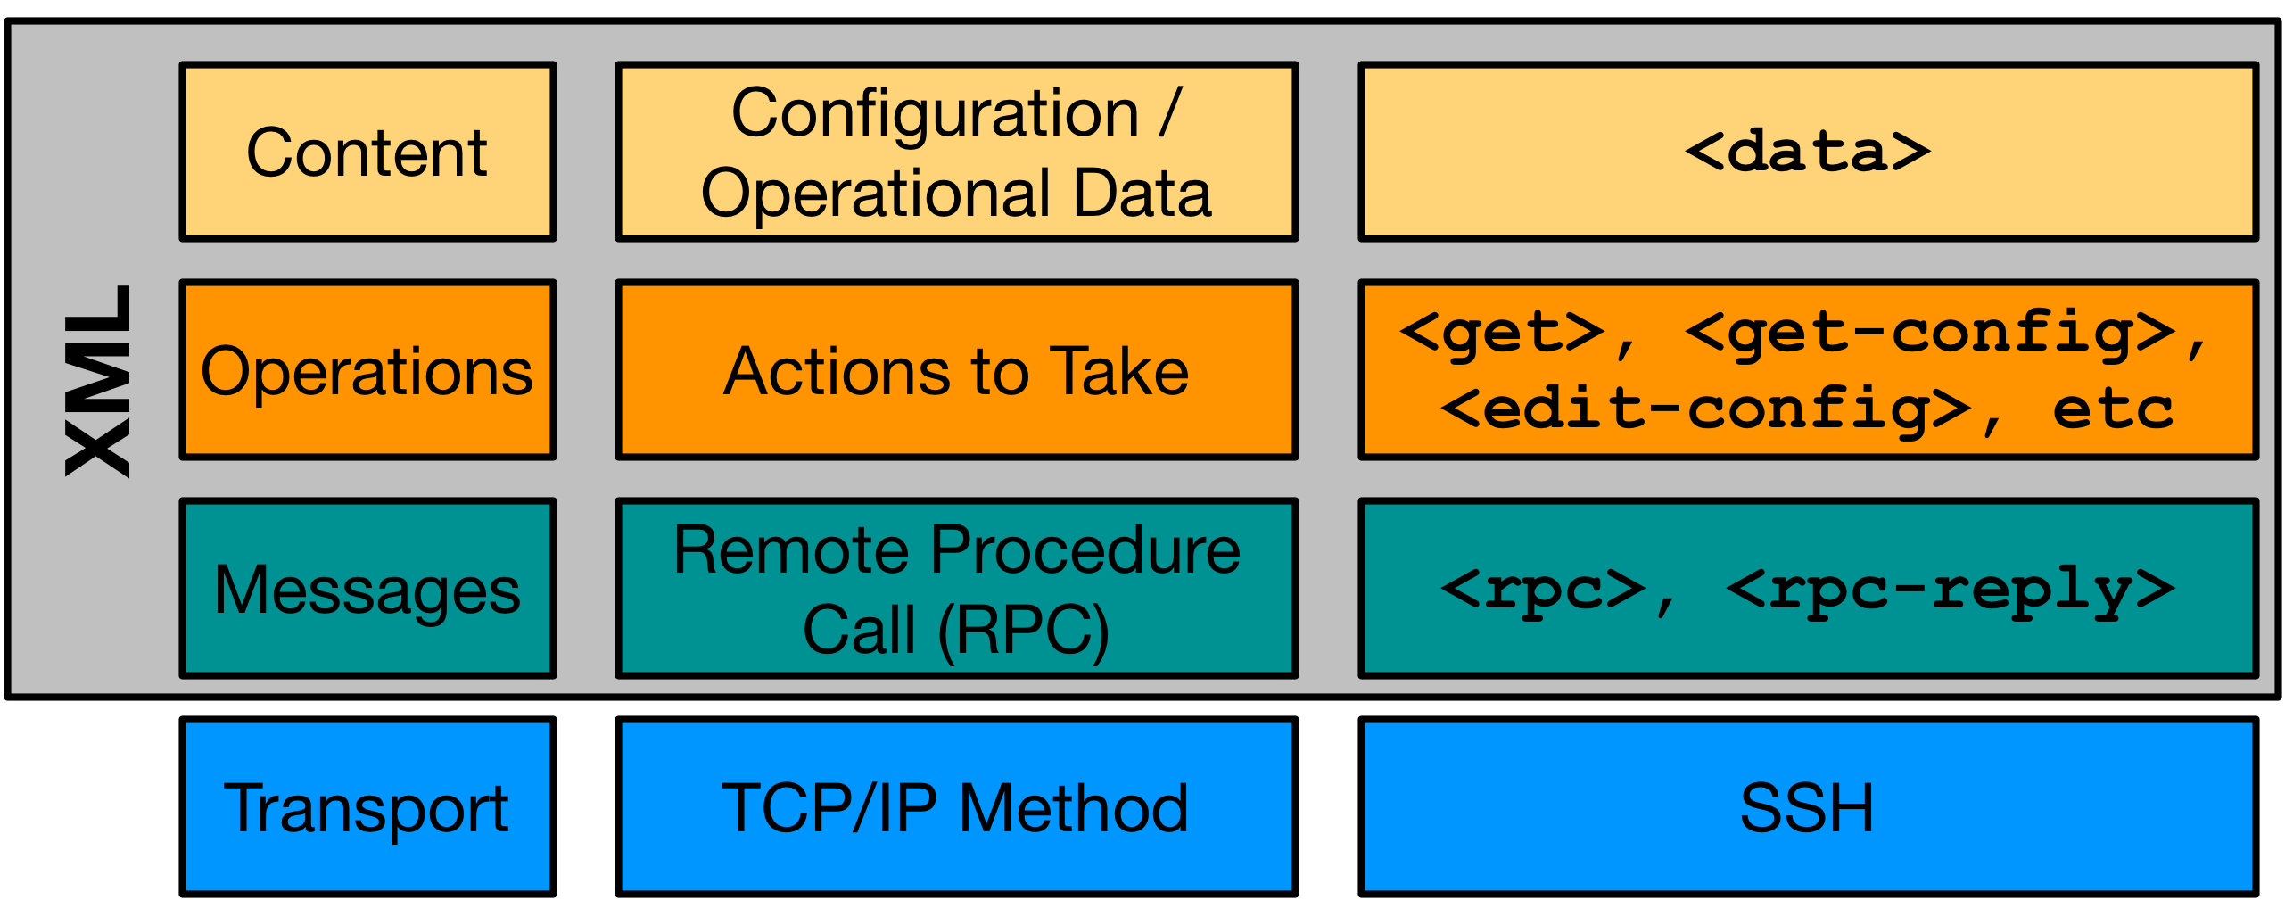
NETCONF Protocol Stack

Slide 34
Transport - SSH
$ ssh admin@192.168.0.1 -p 830 -s netconf
admin@192.168.0.1's password:
SSH Login
<hello xmlns="urn:ietf:params:xml:ns:netconf:base:1.0">
<capabilities>
<capability>urn:ietf:params:netconf:base:1.1</capability>
<capability>urn:ietf:params:netconf:capability:candidate:1.0</capability>
<capability>urn:ietf:params:xml:ns:yang:ietf-netconf-monitoring</capability>
<capability>urn:ietf:params:xml:ns:yang:ietf-interfaces</capability> [output omitted and edited for clarity]
</capabilities>
<session-id>19150</session-id></hello>]]>]]>
Server (Agent) sends hello
<?xml version="1.0" encoding="UTF-8"?>
<hello xmlns="urn:ietf:params:xml:ns:netconf:base:1.0">
<capabilities>
<capability>urn:ietf:params:netconf:base:1.0</capability>
</capabilities>
</hello>]]>]]>
Client (Manager) sends hello
Example edited for simplicity and brevity

Slide 35
Transport - SSH
$ ssh admin@192.168.0.1 -p 830 -s netconf admin@192.168.0.1's password: SSH Login
<hello xmlns="urn:ietf:params:xml:ns:netconf:base:1.0">
<capabilities>
<capability>urn:ietf:params:netconf:base:1.1</capability>
<capability>urn:ietf:params:netconf:capability:candidate:1.0</capability> _{Server (Agent)}
<capability>urn:ietf:params:xml:ns:yang:ietf-netconf-monitoring</capability>
<capability>urn:ietf:params:xml:ns:yang:ietf-interfaces</capability> ^{sends hello}
[output omitted and edited for clarity]
</capabilities>
<session-id>19150</session-id></hello>]]>]]>
<?xml version="1.0" encoding="UTF-8"?>
<hello xmlns="urn:ietf:params:xml:ns:netconf:base:1.0"> Client (Manager)
<capabilities> _{sends hello}
<capability>urn:ietf:params:netconf:base:1.0</capability>
</capabilities> Example edited for simplicity and brevity
</hello>]]>]]>
Don’t NETCONF Like this!

Slide 36
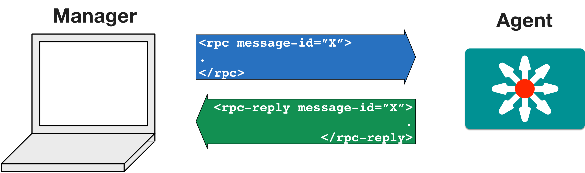
Messages - Remote Procedure Call (RPC)

Slide 37
Operations - NETCONF Actions
Operation | Description
<get> | Retrieve running configuration and device state information
<get-config> | Retrieve all or part of specified configuration data store
<edit-config> | Loads all or part of a configuration to the specified configuration data store
<copy-config> | Replace an entire configuration data store with another
<delete-config> | Delete a configuration data store
<commit> | Copy candidate data store to running data store
<lock> / <unlock> | Lock or unlock the entire configuration data store system
<close-session> | Graceful termination of NETCONF session
<kill-session> | Forced termination of NETCONF session

Slide 38
Additional Operations
The IETF isn’t able to anticipate every use case from every vendor.
Additional operations can be defined by the vendor
Support extended through RPC call to vendor-specific YANG model
write mem?
commit
?
copy run start?

Slide 39
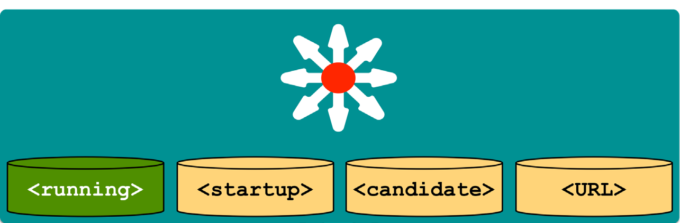
NETCONF Data Stores
Data Store Key Points
Entire or partial configuration
"running" is the only mandatory data store
Not all data stores are writeable
A "URL" data store is supported by IOS to enable <config-copy>
Every NETCONF message must target a data store
result = m.get_config('running')

Slide 40
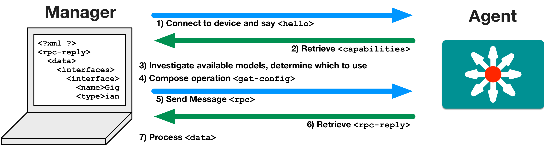
NETCONF Communications

Slide 41
NETCONF in Code with Python

Slide 42
NETCONF and Python: ncclient
Full NETCONF Manager implementation in Python
https://ncclient.readthedocs.io
Simplifies connection and communication.
Deals in raw XML
ncclient – Will list the capability
from ncclient import manager
m = manager.connect(host="192.168.0.1",
port=830, username="admin", password="cisco123", hostkey_verify=False
)
m.close_session()
From: http://ncclient.readthedocs.io/en/latest/

Slide 43
Saying <hello> with Python and ncclient
example1.py: Saying
<hello>
manager.connect() opens NETCONF session with device
Parameters: host & port, user & password
hostkey_verify=False
Trust cert
Stores capabilities
from device_info import ios_xe1 from ncclient import manager
if name == ' main ':
with manager.connect(host=ios_xe1["address"],
port=ios_xe1["port"], username=ios_xe1["username"], password=ios_xe1["password"], hostkey_verify=False) as m:
print("Here are the NETCONF Capabilities") for capability in m.server_capabilities:
print(capability)

Slide 44
Understanding the Capabilities List
DevNet$ python example1.py
Here are the NETCONF Capabilities
urn:ietf:params:netconf:base:1.0 urn:ietf:params:netconf:base:1.1
.
urn:ietf:params:xml:ns:yang:ietf-interfaces?module=ietf-interfaces&revision=2014-05-08&features=pre- provisioning,if-mib,arbitrary-names&deviations=ietf-ip-devs
http://cisco.com/ns/ietf-ip/devs?module=ietf-ip-devs&revision=2016-08-10
y
http://cisco.com/ns/yang/Cisco-IOS-XE-native?module=Cisco-IOS-XE-native&revision=2017-02-07
Two General Types
Base NETCONF capabilities
Data Models Supported

Slide 45
Understanding the Capabilities List
urn:ietf:params:xml:ns:yang:ietf-interfaces
? module=ietf-interfaces & revision=2014-05-08
& features=pre-provisioning,if-mib,arbitrary-names & deviations=ietf-ip-devs
.
http://cisco.com/ns/ietf-ip/devs
? module=ietf-ip-devs & revision=2016-08-10
Data Model Details
Model URI
Module Name and Revision Date
Protocol Features
Example edited for simplicity and brevity
Deviations – Another model that modifies this one

Slide 46
Automate Network with NETCONF

Slide 47
Getting Interface Details with XML Filter
example2.py: Retrieving info with ncclient
Send <get> to retrieve config and state data
Process and leverage XML within Python
Report back current state of interface
from device_info import ios_xe1 from ncclient import manager import xmltodict
# NETCONF filter to use
netconf_filter = open("filter-ietf-interfaces.xml").read()
if name == ' main ':
with manager.connect(host=ios_xe1["address"],
port=ios_xe1["port"], username=ios_xe1["username"], password=ios_xe1["password"], hostkey_verify=False) as m:
# Get Configuration and State Info for Interface
netconf_reply = m.get(netconf_filter)
# Process the XML and store in useful dictionaries
intf_details = xmltodict.parse(netconf_reply.xml)["rpc-reply"]["data"] intf_config = intf_details["interfaces"]["interface"]
intf_info = intf_details["interfaces-state"]["interface"]
print("")
print("Interface Details:")
Name: {}".format(intf_config["name"]))
Description: {}".format(intf_config["description"])) Type: {}".format(intf_config["type"]["#text"]))
MAC Address: {}".format(intf_info["phys-address"]))
Packets Input: {}".format(intf_info["statistics"]["in-unicast-pkts"])) Packets Output: {}".format(intf_info["statistics"]["out-unicast-pkts"]))
print(" print(" print(" print(" print(" print("

Slide 48
Getting Interface Details with XML Filter
example2.py: Retrieving info with ncclient
Send <get> to retrieve config and state data
Process and leverage XML within Python
Report back current state of interface
<filter>
<interfaces xmlns="urn:ietf:params:xml:ns:yang:ietf-interfaces">
<interface>
<name>GigabitEthernet2</name>
</interface>
</interfaces>
<interfaces-state xmlns="urn:ietf:params:xml:ns:yang:ietf-interfaces">
<interface>
<name>GigabitEthernet2</name>
</interface>
</interfaces-state>
</filter>

Slide 49
Getting Interface Details with XML Filter
example2.py: Retrieving info with ncclient
Send <get> to retrieve config and state data
Process and leverage XML within Python
Report back current state of interface
from device_info import ios_xe1 from ncclient import manager import xmltodict
# NETCONF filter to use
netconf_filter = open("filter-ietf-interfaces.xml").read()
if name == ' main ':
with manager.connect(host=ios_xe1["address"],
port=ios_xe1["port"], username=ios_xe1["username"], password=ios_xe1["password"], hostkey_verify=False) as m:
# Get Configuration and State Info for Interface
netconf_reply = m.get(netconf_filter)
# Process the XML and store in useful dictionaries
intf_details = xmltodict.parse(netconf_reply.xml)["rpc-reply"]["data"] intf_config = intf_details["interfaces"]["interface"]
intf_info = intf_details["interfaces-state"]["interface"]
print("")
print("Interface Details:")
Name: {}".format(intf_config["name"]))
Description: {}".format(intf_config["description"])) Type: {}".format(intf_config["type"]["#text"]))
MAC Address: {}".format(intf_info["phys-address"]))
Packets Input: {}".format(intf_info["statistics"]["in-unicast-pkts"])) Packets Output: {}".format(intf_info["statistics"]["out-unicast-pkts"]))
print(" print(" print(" print(" print(" print("

Slide 50
Getting Interface Details
DevNet$ python example2.py
Interface Details:
Name: GigabitEthernet2 Description: DON'T TOUCH ME Type: ianaift:ethernetCsmacd MAC Address: 00:50:56:bb:74:d5 Packets Input: 592268689
Packets Output: 21839

Slide 51
Getting Interface Details with XPath
example3.py: Retrieving info with ncclient and XPath
Send <get> to retrieve and state data
Process the data
Report back current state of interface
from device_info import ios_xe1 from ncclient import manager import xmltodict
if name == ' main ':
with manager.connect(host=ios_xe1["address"],
port=ios_xe1["port"], username=ios_xe1["username"], password=ios_xe1["password"], hostkey_verify=False) as m:
# Get Configuration and State Info for Interface
netconf_reply = m.get(filter=('xpath' ,
"/interfaces-state/interface[name='GigabitEthernet1']" "/statistics/out-unicast-pkts"))
intf_details = xmltodict.parse(netconf_reply.xml)["rpc-reply"]["data"] intf_info = intf_details["interfaces-state"]["interface"]
print("")
print("Interface Details:")
print(" Name: {}".format(intf_info["name"]))
print(" Packets Output: {}".format(intf_info["statistics"]["out-unicast-pkts"]))
DevNet$python example3.py
Interface Details:
Name: GigabitEthernet1 Packets Output: 415200

Slide 52
Configuring Interface Details
from device_info import ios_xe1 from ncclient import manager
example4.py: Editing configuration with ncclient
Constructing XML Config Payload for NETCONF
Sending <edit-config> operation with ncclient
Verify result
# NETCONF Config Template to use
netconf_template = open("config-temp-ietf-interfaces.xml").read()
if name == ' main ':
# Build the XML Configuration to Send
netconf_payload = netconf_template.format(int_name="GigabitEthernet2",
int_desc="Configured by NETCONF", ip_address="10.255.255.1", subnet_mask="255.255.255.0"
)
print("Configuration Payload:") print(" ")
print(netconf_payload)
with manager.connect(host=ios_xe1["address"], port=ios_xe1["port"],
username=ios_xe1["username"], password=ios_xe1["password"], hostkey_verify=False) as m:
# Send NETCONF <edit-config>
netconf_reply = m.edit_config(netconf_payload, target="running")
# Print the NETCONF Reply
print(netconf_reply)

Slide 53
Configuring Interface Details
config-temp-ietf-interfaces.xml
<config>
<interfaces xmlns="urn:ietf:params:xml:ns:yang:ietf-interfaces">
<interface>
<description>{int_desc}</description>
<type xmlns:ianaift="urn:ietf:params:xml:ns:yang:iana-if-type">ianaift:ethernetCsmacd</type>
<enabled>true</enabled>
<ipv4 xmlns="urn:ietf:params:xml:ns:yang:ietf-ip">
<address>
<ip>{ip_address}</ip>
<netmask>{subnet_mask}</netmask>
</address>
</ipv4>
</interface>
</interfaces>
</config>
example4.py: Editing configuration with ncclient
Constructing XML Config Payload for NETCONF
Sending <edit-config> operation with ncclient
Verify result
<name>{int_name}</name>
if name == ' main ':
# Build the XML Configuration to Send
netconf_payload =
netconf_template.format(int_name="GigabitEthernet2",
int_desc="Configured by NETCONF", ip_address="10.255.255.1", subnet_mask="255.255.255.0"
)
print("Configuration Payload:") print(" ") print(netconf_payload)

Slide 54
Configuring Interface Details
from device_info import ios_xe1 from ncclient import manager
# NETCONF Config Template to use
netconf_template = open("config-temp-ietf-interfaces.xml").read()
if name == ' main ':
# Build the XML Configuration to Send
netconf_payload = netconf_template.format(int_name="GigabitEthernet2",
int_desc="Configured by NETCONF", ip_address="10.255.255.1", subnet_mask="255.255.255.0"
)
print("Configuration Payload:") print("----------------------")
print(netconf_payload)
with manager.connect(host=ios_xe1["address"], port=ios_xe1["port"],
username=ios_xe1["username"], password=ios_xe1["password"], hostkey_verify=False) as m:
# Send NETCONF <edit-config>
netconf_reply = m.edit_config(netconf_payload, target="running")
# Print the NETCONF Reply
print(netconf_reply)
example4.py: Editing configuration with ncclient
Constructing XML Config Payload for NETCONF
Sending <edit-config> operation with ncclient
Verify result

Slide 55
Configuring Interface Details
DevNet$ python -i example4.py Configuration Payload:
<config>
<interfaces xmlns="urn:ietf:params:xml:ns:yang:ietf-interfaces">
<interface>
<name>GigabitEthernet2</name>
<description>Configured by NETCONF</description>
<type xmlns:ianaift="urn:ietf:params:xml:ns:yang:iana-if-type"> ianaift:ethernetCsmacd
</type>
<enabled>true</enabled>
<ipv4 xmlns="urn:ietf:params:xml:ns:yang:ietf-ip">
<address>
<ip>10.255.255.1</ip>
<netmask>255.255.255.0</netmask>
</address>
</ipv4>
</interface>
</interfaces>
</config>
<?xml version="1.0" encoding="UTF-8"?>
<rpc-reply xmlns=”urn.." message-id=”..9784" xmlns:nc="urn..">
<ok/>
</rpc-reply>
Example edited for simplicity and brevity

Slide 56
Saving Running Configuration with ncclient
example5.py: Save running configuration with ncclient
Constructing XML Config Payload for NETCONF
Sending custom save operation with ncclient
Verify result
from device_info import ios_xe1 from ncclient import manager, xml_
if name == ' main ':
with manager.connect(host=ios_xe1["address"],
port=ios_xe1["port"], username=ios_xe1["username"], password=ios_xe1["password"], hostkey_verify=False) as m:
# Build XML Payload for the RPC
save_body = '<cisco-ia:save-config xmlns:cisco-ia="http://cisco.com/yang/cisco-ia"/>'
# Send the RPC to the Device
save_rpc = m.dispatch(xml_.to_ele(save_body))
# Print the NETCONF Reply
print(save_rpc)
60

Slide 57
Saving Running Configuration with ncclient
<?xml version="1.0" encoding="UTF-8"?>
<rpc-reply xmlns="urn:ietf:params:xml:ns:netconf:base:1.0" message-id="urn:uuid:d12c3cc5-f638-499e-9e57-c8d2402fdfeb" xmlns:nc="urn:ietf:params:xml:ns:netconf:base:1.0">
</rpc-reply>
<result xmlns='http://cisco.com/yang/cisco-ia'>
Save running-config successful
</result>
61

Slide 58
NETCONF Summary

Slide 59
NETCONF Summary
The elements of the NETCONF transport protocol
How to leverage ncclient to use NETCONF in Python
Examples retrieving and configuring data from a NETCONF Agent
63

Slide 60
Understanding RESTCONF

Slide 61
RESTCONF Details
RFC 8040 - January 2017
Uses HTTPS for transport
Tightly coupled to the YANG data model definitions
Provides JSON or XML data formats
“an HTTP-based protocol that provides a programmatic interface for accessing data defined in YANG…”
https://tools.ietf.org/html/rfc8040

Slide 62
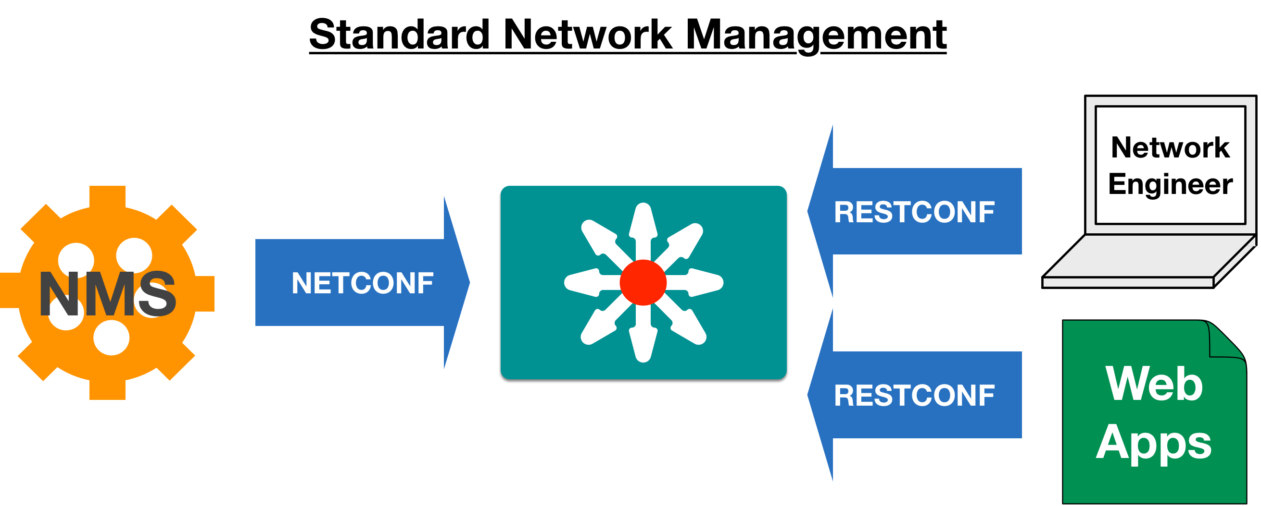
What about NETCONF?

Slide 63
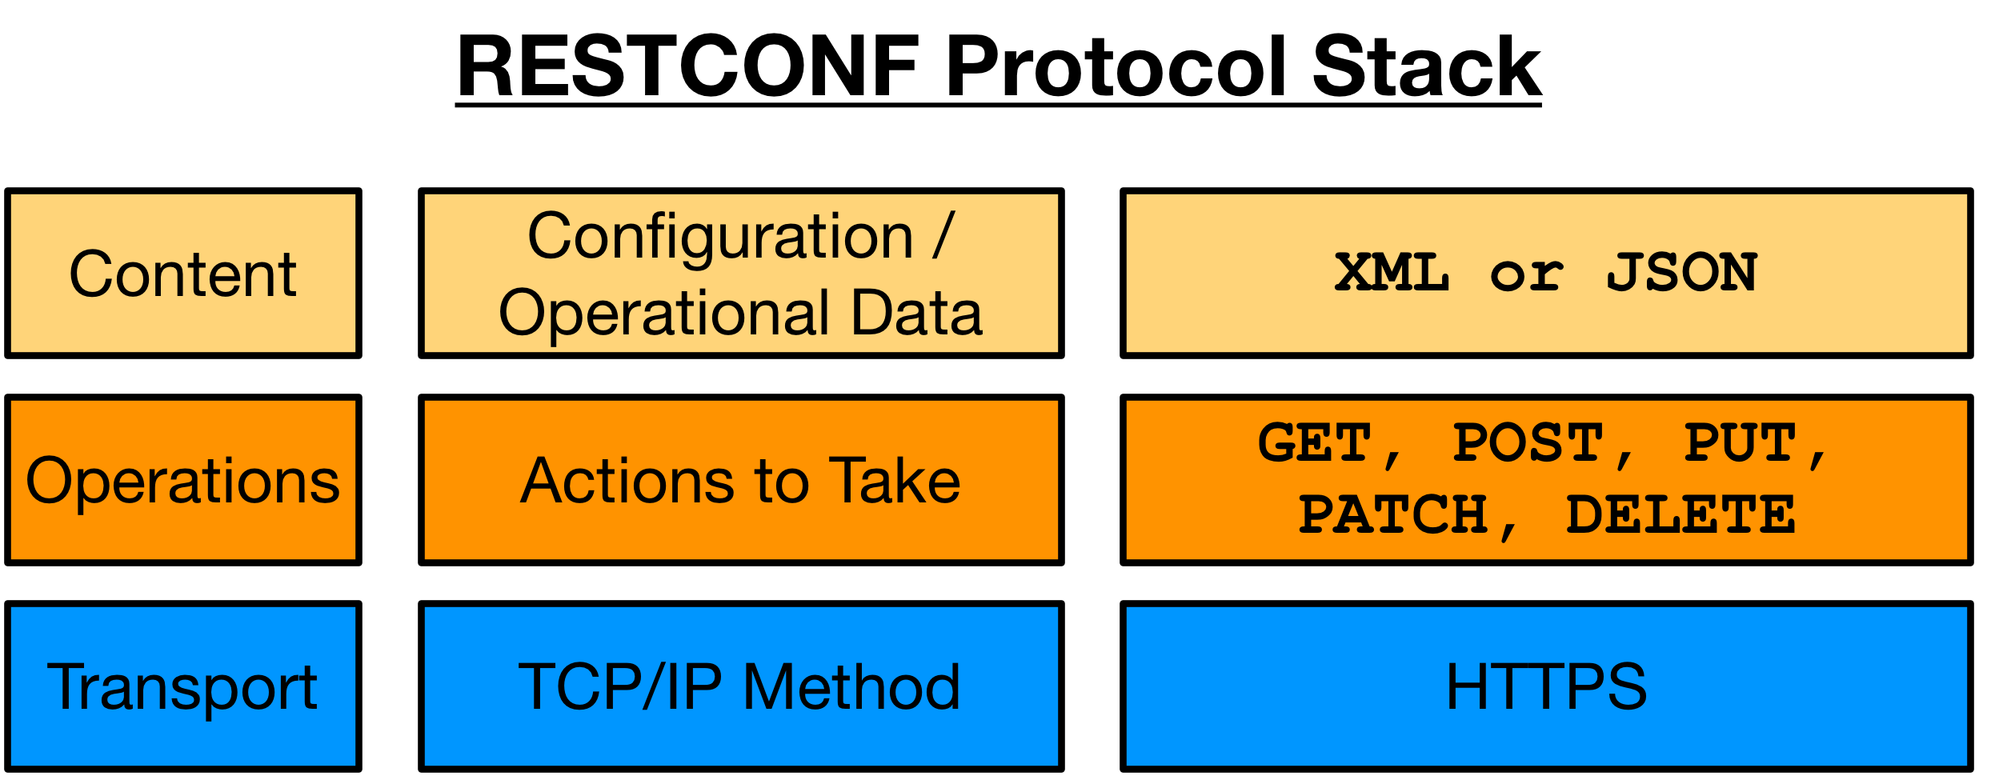
RESTCONF Protocol Stack & Transport

Slide 64
Operations - HTTP CRUD
RESTCONF | NETCONF
GET | <get> , <get-config>
POST | <edit-config> (operation="create")
PUT | <edit-config> (operation="create/replace")
PATCH | <edit-config> (operation="merge")
DELETE | <edit-config> (operation="delete")

Slide 65
Content - XML or JSON
HTTP Headers
Content-Type: Specify the type of data being sent from the client
Accept: Specify the type of data being requested by the client
RESTCONF MIME Types
application/yang-data+json
application/yang-data+xml

Slide 66
Constructing RESTCONF URIs for Data Resources
https://<ADDRESS>/<ROOT>/data/<[YANG MODULE:]CONTAINER>/<LEAF>[?<OPTIONS>]
ADDRESS - Of the RESTCONF Agent
ROOT - The main entry point for RESTCONF requests. Discoverable at https://<ADDRESS>/.well-known/host-meta
data - The RESTCONF API resource type for data
The “operations” resource type used to access RPC operations available
[YANG MODULE:]CONTAINER - The base model container being used. Providing the module name is optional.
LEAF - An individual element from within the container
[?<OPTIONS>] - optional parameters that impact returned results.

Slide 67
URL Creation Review
https://<ADDRESS>/restconf/data/ietf-interfaces:interfaces/interface=GigabitEthernet1?depth=unbounded
module: ietf-interfaces
+--rw interfaces
| | +--rw interface* [name]
| | +--rw name | string
| | +--rw description? | string
| | +--rw type | identityref
| | +--rw enabled? | boolean
| | +--rw link-up-down-trap-enable? | enumeration
Options Examples:
depth=unbounded
Follow nested models to end. Integer also supported
content=[all, config, nonconfig]
Query option controls type of data returned.
fields=expr
Limit what leafs are returned
{if-mib}?
Key:
https://<ADDRESS>/<ROOT>/data>/<[YANG MODULE:]CONTAINER>/<LEAF>[?<OPTIONS>]

Slide 68
Using RESTCONF with Postman

Slide 69

Postman: Powerful but Simple REST API Client
Quickly test APIs in GUI
Save APIs into Collections for reuse
Manage multiple environments
Auto generate code from API calls
https://www.getpostman.com

Slide 70
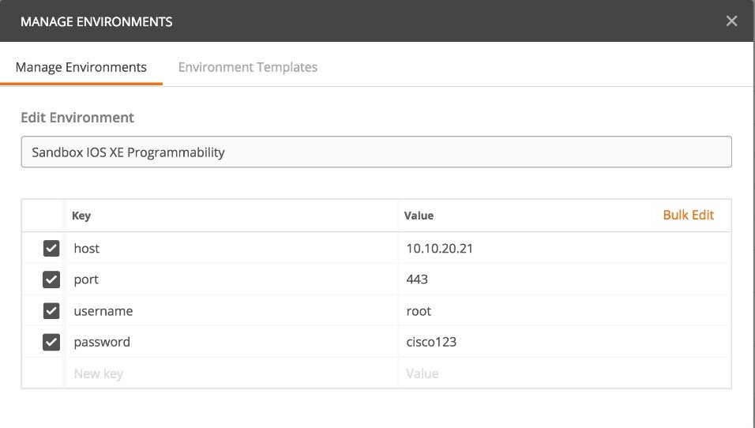
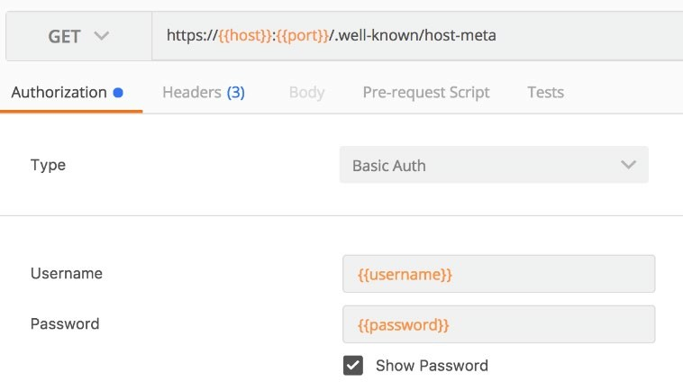
Setup Environment for RESTCONF
Add variables for host, and credentials
Reference anywhere with {{variable name}} syntax

Slide 71
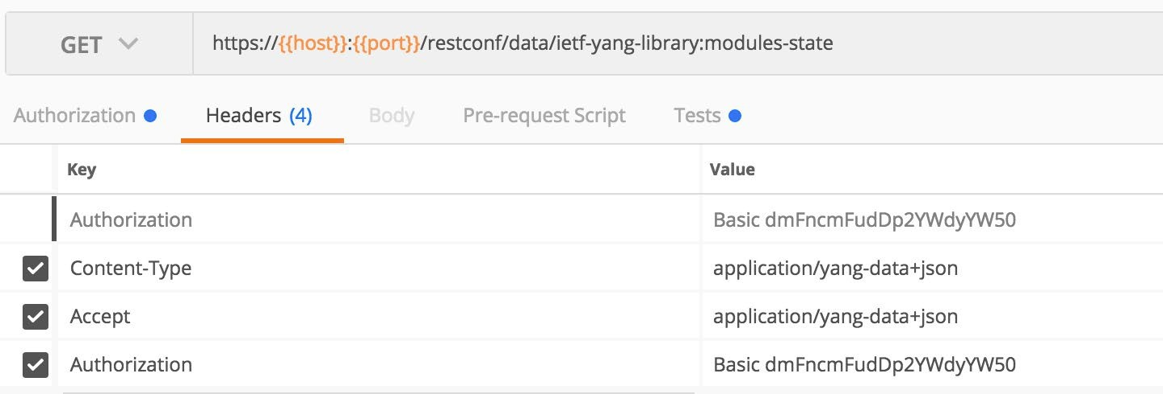
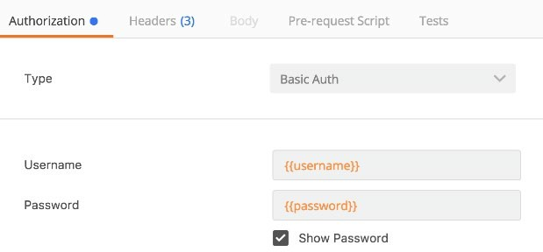
Step 1: Get YANG Modules List via RESTCONF
GET /restconf/data/ietf-yang-library:modules-state
Add RESTCONF Headers
Content-Type and Accept application/yang-data+json (or xml)
Configure Basic Auth with username and password variables
Example –
• CSR1000V Host: ios-xe-mgmt.cisco.com ◦ RESTCONF Ports: 9443 (HTTPS) • Username: developer • Password: C1sco12345
https://64.103.37.51:9443/restconf/data/ietf-yang-library:modules-state

Slide 72
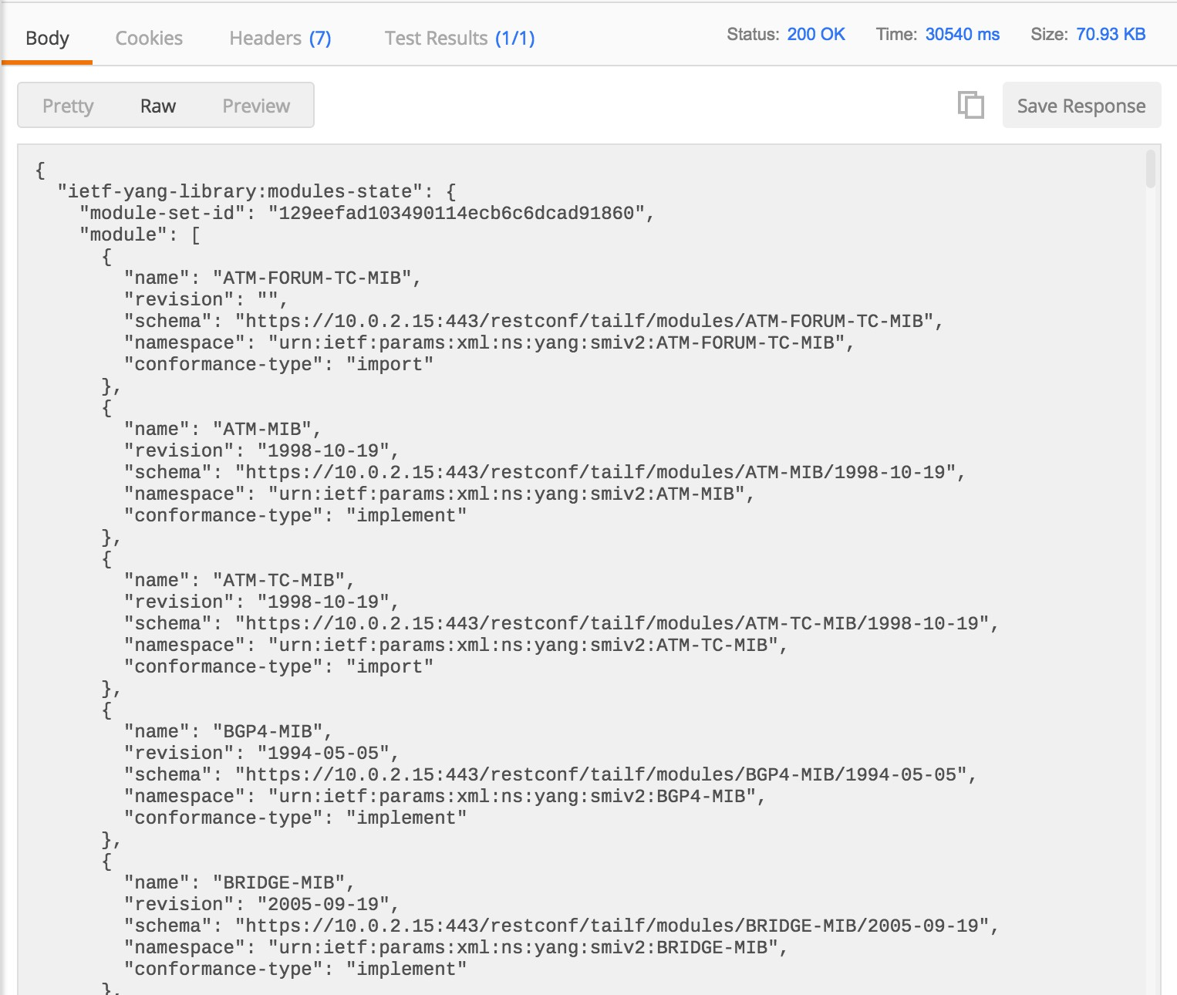
Step 1: Get YANG Modules List via RESTCONF
Send and review results

Slide 73
Understanding the YANG Modules List
{"ietf-yang-library:modules-state": {"module": [
{
"name": "ietf-ip",
"revision": "2014-06-16",
"schema": "https://10.10.20.48:443/restconf/tailf/..", "namespace": "urn:ietf:params:xml:ns:yang:ietf-ip", "feature": [
"ipv6-privacy-autoconf", "ipv4-non-contiguous-netmasks"
],
"deviation": [
{
"name": "cisco-xe-ietf-ip-deviation", "revision": "2016-08-10"
}
],
"conformance-type": "implement"
},
{
"name": "cisco-xe-ietf-ip-deviation", "revision": "2016-08-10",
"schema": "https://10.10.20.48:443/restconf/tailf/...", "namespace": "http://cisco.com/ns/cisco-xe-ietf-ip-deviation", "conformance-type": "implement"
Data Model Details
Model URI
Module Name and Revision Date
Protocol Features
Deviations – Another model that modifies this one
}]}}

Slide 74
Automate Network with RESTCONF

Slide 75
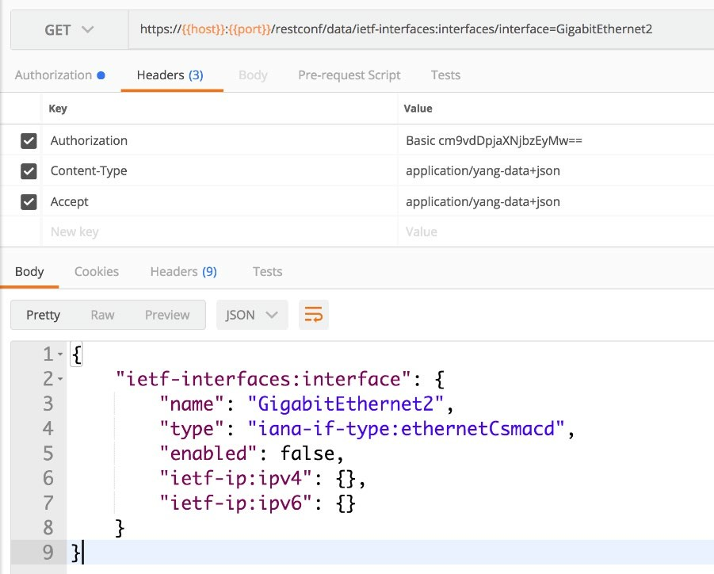
Getting Interface Details
GET
restconf/data/ietf-interfaces:interfaces/interface=GigabitEthernet2
Configure Auth and Headers

Slide 76
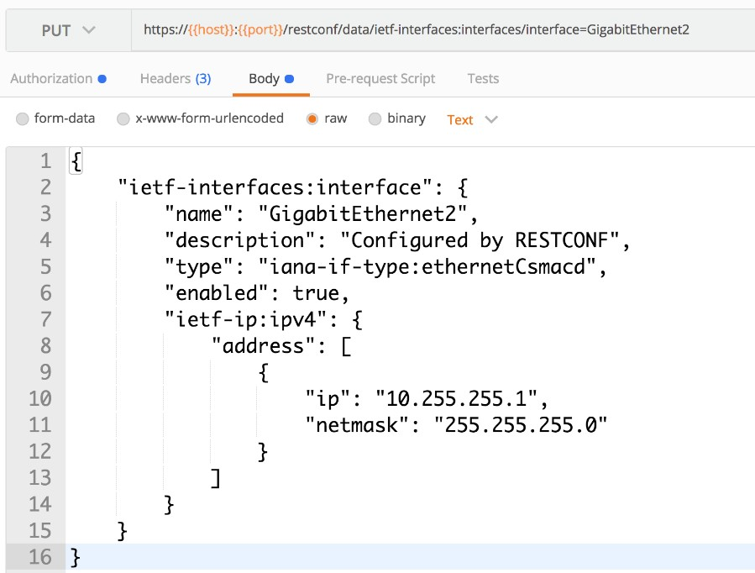
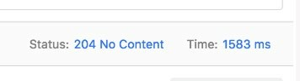
Configuring Interface Details
PUT
restconf/data/ietf-interfaces:interfaces/interface=GigabitEthernet2
Configure Auth and Headers
Configure Body (raw)
Send and check status code

Slide 77
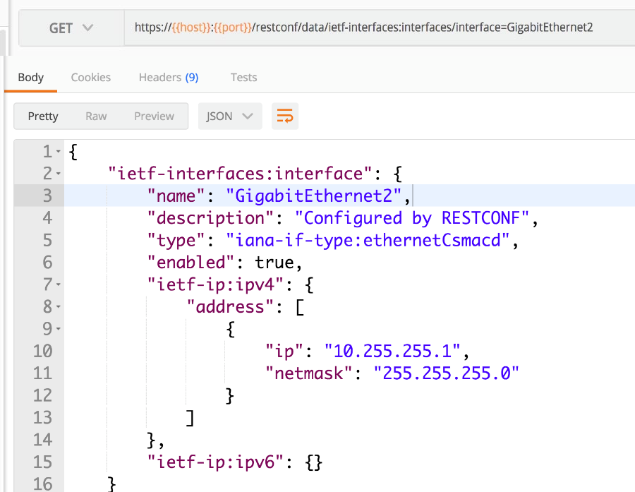
Configuring Interface Details - Verification
GET
restconf/data/ietf-interfaces:interfaces/interface=GigabitEthernet2
Configure Auth and Headers
Check that the new config was successful

Slide 78
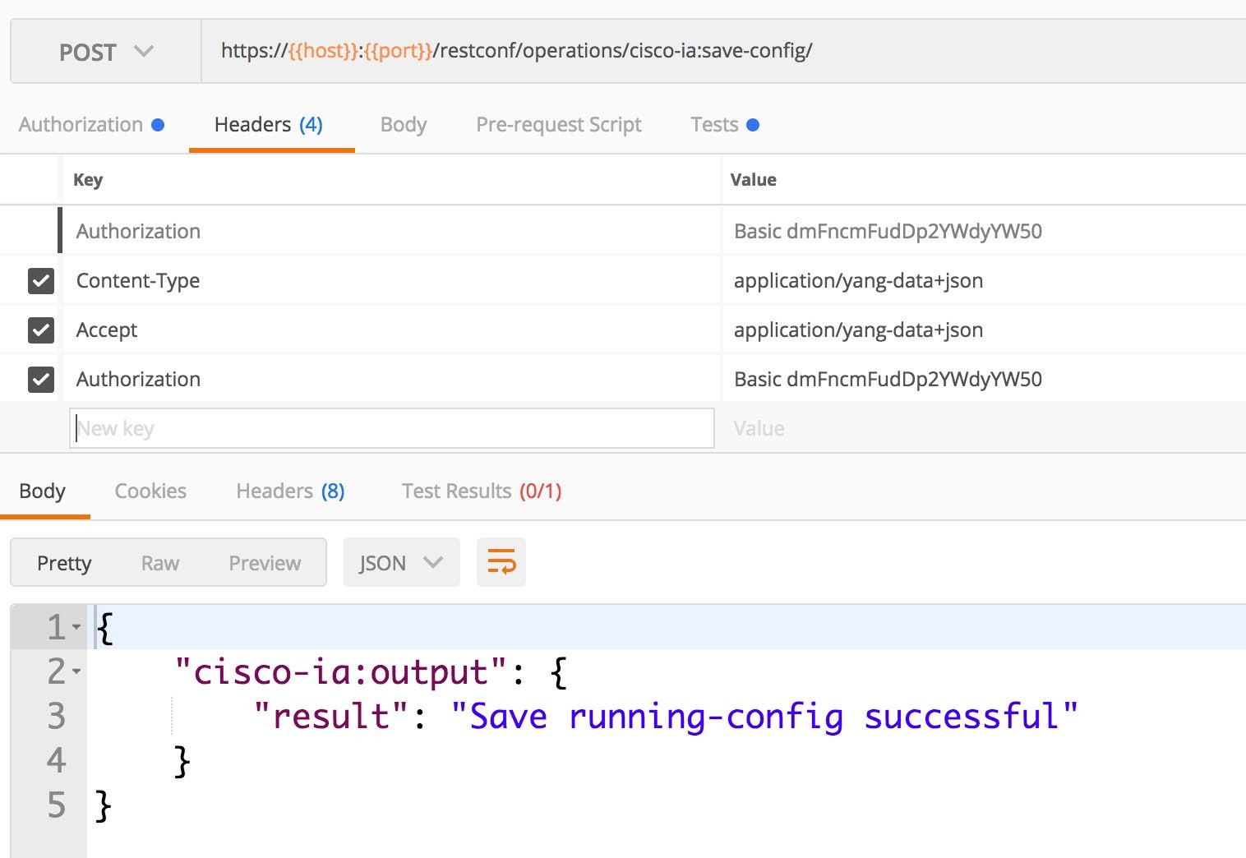
Save Running Configuration to Startup RPC Operation
POST
restconf/operations/cisco-ia:save-config/
Configure Auth and Headers

Slide 79
RESTCONF with Python

Slide 80
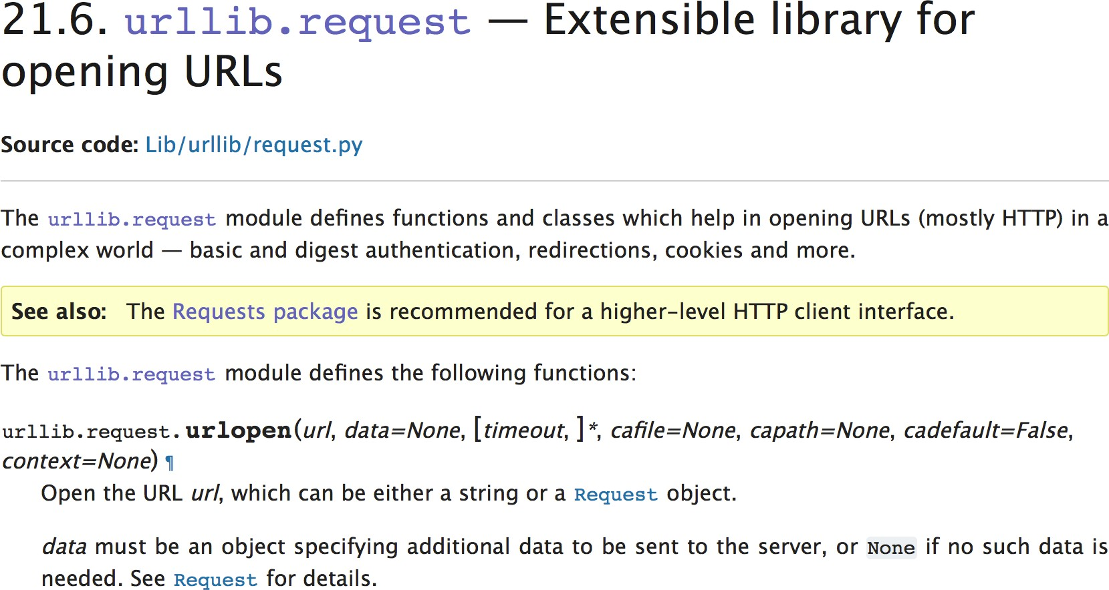
Python Libraries for RESTCONF
Treat like other “REST” and HTTP APIs
Core Python Library
urllib (urllib.request)
Other HTTP Library
Requests: http for humans
84

Slide 81


RESTCONF and HTTPS/SSL
Per RFC8040 RESTCONF requires HTTPS for security
HTTPS leverages SSL/TLS certificates to
Encrypt data transmitted between server and client
Verify a sites identity
Encryption accomplished through Private/Public keys in Certificate
Identity is all about “trust” and the “signer” of a certificate
85

Slide 82
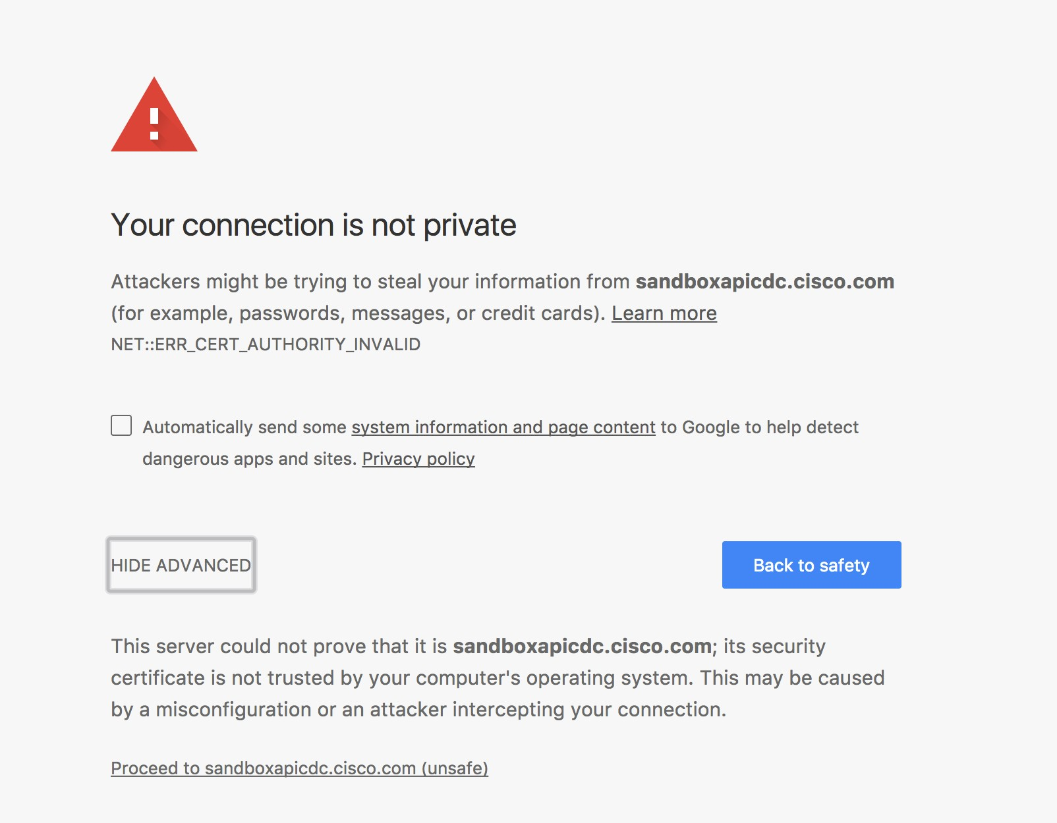
Self-Signed SSL Certificates are Common
No problems with encryption
“Trust” fails due to no Certificate Authority
Common in most of our daily lives
Network web GUIs
Internal corporate web sites
Poorly managed company sites
Knee-jerk reaction to click “Accept” or “Proceed”
86

Slide 83

“Accepting” Self-Signed Certificates with Python Requests
Requests (via urllib) performs SSL Validation by default
>>> import requests
>>> url = "https://ios-xe-mgmt.cisco.com:9443/.well-known/host-meta"
>>>
Traceback (most recent call last):
File "<pyshell#7>", line 1, in <module>
response = requests.get(url, auth=("root", "D_Vay!_10&"))
SSLError: HTTPSConnectionPool(host='ios-xe-mgmt.cisco.com', port=9443): Max retries exceeded with url: /.well-known/host-meta (Caused by SSLError(SSLError(1, u'[SSL: CERTIFICATE_VERIFY_FAILED]
certificate verify failed (_ssl.c:661)'),))
response = requests.get(url, auth=("root", "D_Vay!_10&"))
87

Slide 84
“Accepting” Self-Signed Certificates with Python Requests
Disable with
verify = False
Still generates a Warning notification
But the request is successful
>>> import requests >>> url = "https://ios-xe-mgmt.cisco.com:9443/.well-known/host-meta" >>> response = requests.get(url, auth=("root", "D_Vay!_10&"), verify=False) Warning (from warnings module): File "/Users/hapresto/coding/BRKDEV-1368/venv/lib/python2.7/site- packages/urllib3/connectionpool.py", line 858 InsecureRequestWarning) InsecureRequestWarning: Unverified HTTPS request is being made. Adding certificate verification is strongly advised. See: https://urllib3.readthedocs.io/en/latest/advanced-usage.html#ssl-warnings
>>> print(response.text) <XRD xmlns='http://docs.oasis-open.org/ns/xri/xrd-1.0'> <Link rel='restconf' href='/restconf'/> </XRD>
88

Slide 85
Disabling Insecure SSL Warnings from urllib
Import urllib
Disable warnings
>>> requests.packages.urllib3.disable_warnings()
>>> response = requests.get(url, auth=("root", "D_Vay!_10&"), verify=False)
>>> print(response.text)
<XRD xmlns='http://docs.oasis-open.org/ns/xri/xrd-1.0'>
<Link rel='restconf' href='/restconf'/>
</XRD>
89

Slide 86
RESTCONF in Python
# Used to configure the IP address on an interface
def configure_ip_address(interface, ip):
# RESTCONF URL for specific interface
url = url_base + "/data/ietf-interfaces:interfaces/interface={i}".format(i=interface)
Example function to configure IP with RESTCONF
Using “requests”
# Create the data payload to reconfigure IP address
# Need to use OrderedDicts to maintain the order of elements
data = OrderedDict([('ietf-interfaces:interface', OrderedDict([
('name', interface),
('type', 'iana-if-type:ethernetCsmacd'), ('ietf-ip:ipv4',
OrderedDict([
('address', [OrderedDict([ ('ip', ip["address"]),
('netmask', ip["mask"])
])]
)
])
),
])
)])
# Use PUT request to update data
response = requests.put(url,
auth=(USER, PASS),
headers=headers, verify=False, json=data
)
print(response.text)
90

Slide 87
Is RESTCONF a REST API?
It depends…
(of course it does)
91

Slide 88
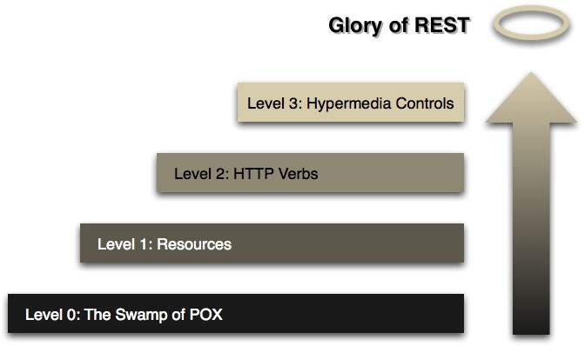
Richardson Maturity Model for REST
RESTCONF is a Level 2 REST API
RESTCONF targets resources
RESTCONF uses HTTP Verbs
RESTCONF doesn’t use Hypermedia Controls
Source: https://martinfowler.com/articles/richardsonMaturityModel.html
92

Slide 89
RESTCONF Summary

Slide 90
Review
The elements of the RESTCONF transport protocol
How to leverage Postman to use RESTCONF
Examples retrieving and configuring data using RESTCONF
Yep, RESTCONF is a REST API!
BRKDEV-1368
© 2020 Cisco and/or its affiliates. All rights reserved. Cisco Public
94

Slide 91
DEMO

Slide 92
Questions?

Slide 93
What do do next?
Resources
Overview of the 2002 IAB Network Management Workshop
Network Configuration Protocol (NETCONF)
The YANG 1.1 Data Modeling Language
RESTCONF Protocol
YANG Development Kit (YDK)
DevNet Learning Labs
Introduction to Device Level Interfaces - NETCONF/YANG
NETCONF/YANG on Nexus
Home Lab: Using NETCONF/YANG from your Desktop OS
Blogs and Videos
Using CLI as Training Wheels with NETCONF/YANG
Simplifying Network Programmability with Model Driven APIs
Network Device APIs Video Lessons

Slide 94
References
BRKDEV-1368 by Hank Preston

